Slide 1
Agentic RAG with MCP

Slide 2
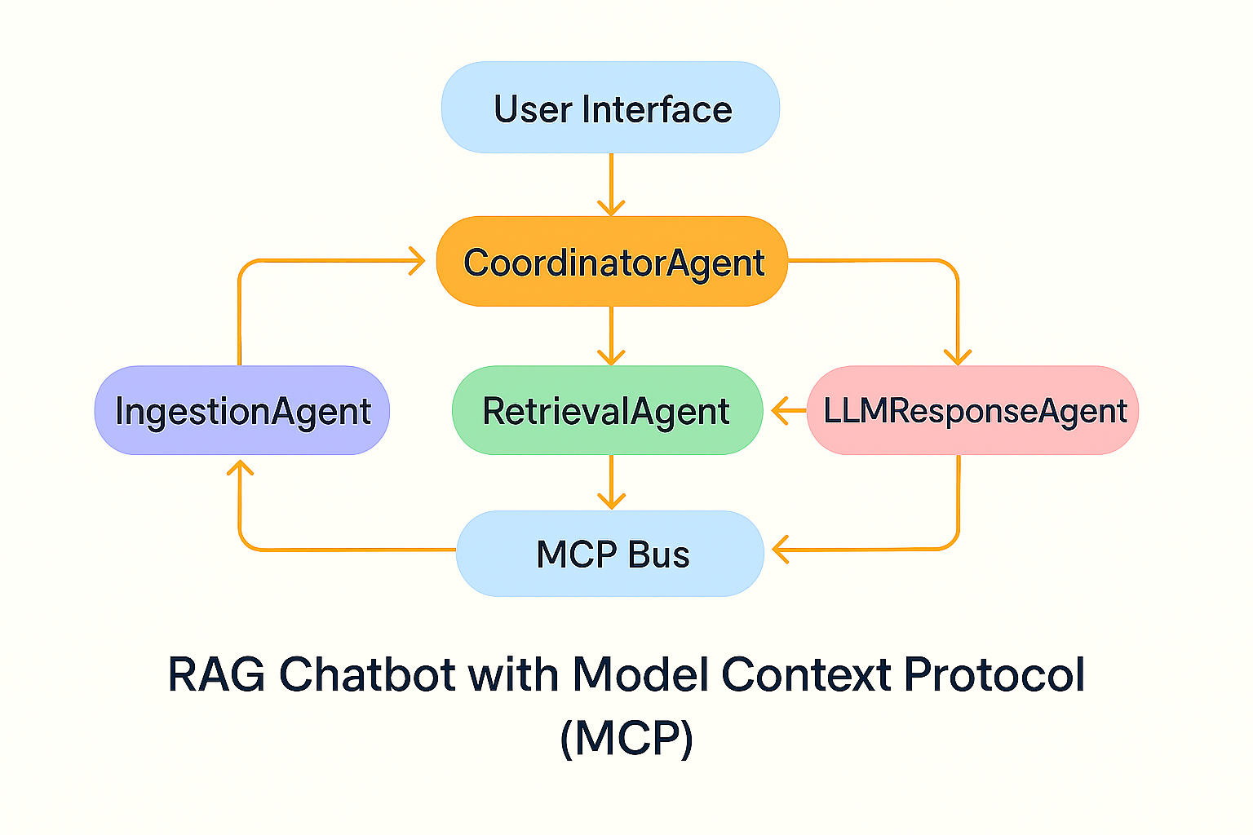
Architecture / System-Flow

Slide 3
Tech Stack Used
UI | Streamlit
LLM | Groq (LLAMA 3)
Vector DB | FAISS
Embeddings | Sentence Transformers
File Parsing | PyMuPDF, Pandas
Protocol | In-memory MCP JSON

Slide 4
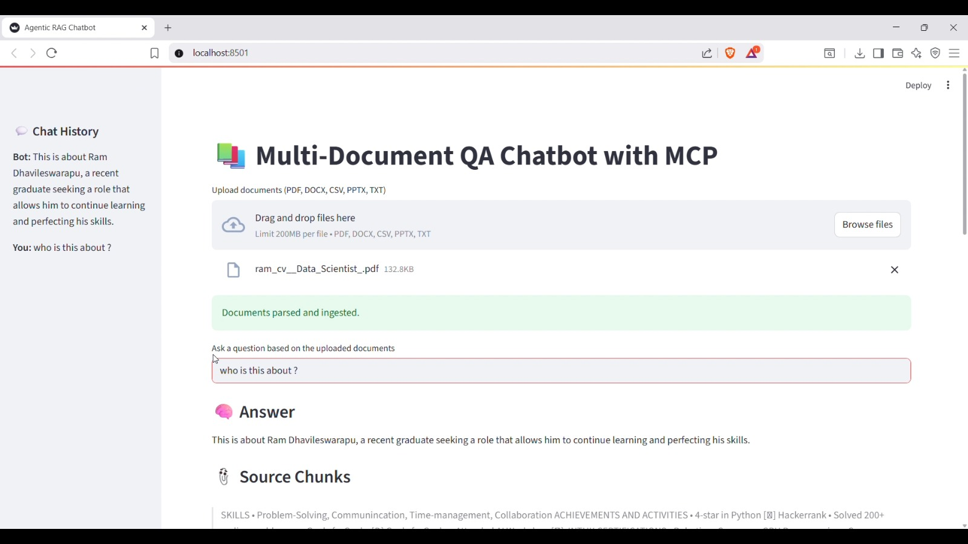
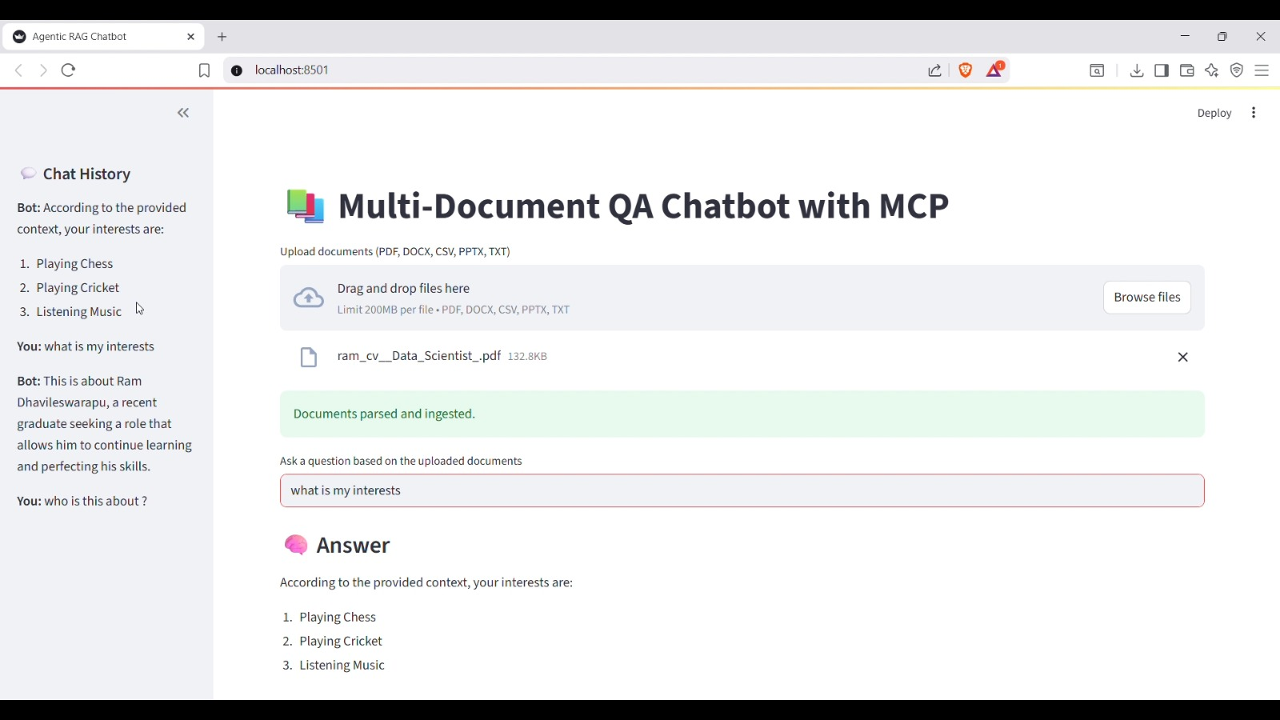
Demo

